Slide 1
Visualizations and Animations
EDC&I 583
Message Design
22 February 2012

Slide 2
This Evening’s Agenda
Good and Bad Examples
Visual Complexity site: Your likes, dislikes
Presentation on Visualizations and Animations
Discussion: Tufte
Re-design Presentations
Project check-in
Project Evaluation Criteria
Designing next week’s class session

Slide 3
Visualizations and Animations Bringing Data to Life
Proposition*:
Computer power
plus
Increased ability to generate, collect, organize, analyze, and present information
results in
a quantum leap in our ability to think with information
*With apologies to V. I. Lenin: “Коммунизм есть Советская власть плюс электрификация всей страны.”

Slide 4
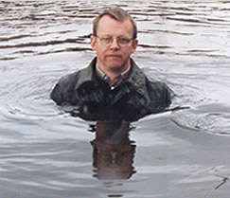
Hans Rosling
Swedish Public health official and doctor
Good data visualization changes perceptions, leads to action
Promoting a “fact-based worldview”
BBC, TED talks
How he thinks about his method…

Slide 5
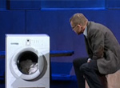
An Agenda for Development and Change
Concern for economic differences, development directions around the world
Washing Machine = “most important device of the industrial revolution”
Esp. in context of women’s lives

Slide 6
Gapminder
Rosling created (w. son & dau-in-law) Gapminder Foundation
Developed Trendalyzer visualization software
Other similar projects:
Trend Compass
Eurostat Euro eXplorer

Slide 7
What Do Animated Visualizations Do?
Allow us to experience what our senses can’t:
Passage of time (what happened before/after what)
How data aggregates (what happens when something else is happening)
Relations among variables (what changes with what)
Conceptualizing abstractions
Sequence of events (what leads to what)
Go beyond our usual scale (big/little)
Imagine things that don’t exist

Slide 8
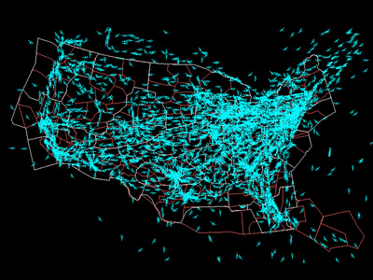
Passage of Time/Data Aggregation Air Traffic
One day in the life of…
USA air traffic

Slide 9
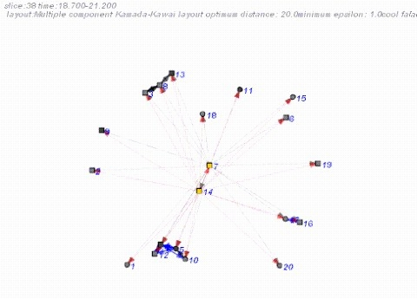
Relations among Variables Sociograms
High school economics class (11-12 grade) at a magnet high school
Two teachers: usual teacher, volunteer businessman
Class project: stock market mock investments
Conversation turns - pairs of senders and receivers, types of content.
Speakers activity coded for :
(1) indirect soundings, such as lectures (where a teacher addresses all students); and
(2) direct interactions that are focused on particular others.
2.5 min. time slices

Slide 10
Conceptualizing Abstractions Seattle Public Library
George Legrady
Exhibit: Making Visible the Invisible, 2005-2014
Materials circulating
Chrono sequence of materials checked out
Items sorted by Dewey Decimal number
Keywords associated with all titles checked out in last hour

Slide 11
Sequence of Interrelated Events
RSA Animate: Ken Robinson on Changing Educational Paradigms
This one actually starts with a description of today, then goes backwards in time

Slide 12
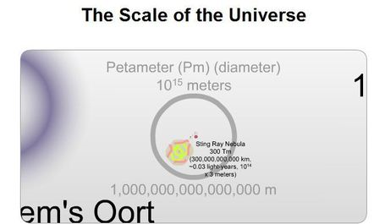
Going beyond Scale
Stuff that’s too big, too small for our senses to easily handle
Close-up of a single neuron
Relative size of things in the universe

Slide 13
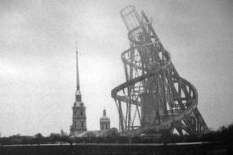
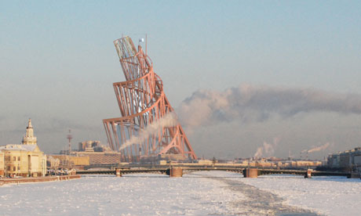
Things that Don’t Exist
Vladimir Tatlin’s plan for a Monument to the Third International, (Russia, 1920s)
Never actually constructed
But influential among architects
Many efforts to visualize “What might have been…”

Slide 14
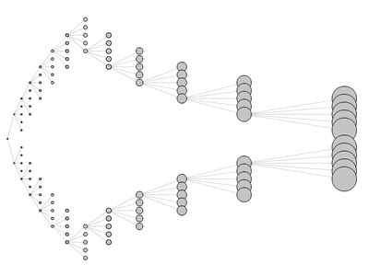
Software Systems Lining Up to Support Visualization
WikiViz
Flare
WikiViz (wiki for visualization software)

Slide 15
Tufte Questions for Discussion
Identify (1 per group) one Tuftean position with which you agree and apply it to a practical design issue
Identify (1 per group) one Tuftean position with which you disagree and identify how you would subject it to empirical testing

Slide 16
Project Evaluation Criteria
Description of the design issue/problem you worked on
Your rationale for why you presented your message in the way you did
Your justification of choices made, based on graphic design principles, research, and theory

Slide 17
Class Next Week (2/29)
What the syllabus says:
“New and Critical perspectives: Against dancing penguins (Accessibility; research approaches; web site design; educational implications).”
What else would be interesting? (Or, how to approach these issues?)
Also: Set the agenda for our final meeting and in-class presentation of projects on March 7

